Slide 1

Team Moneyball Data Analysis
May 2022

Slide 2
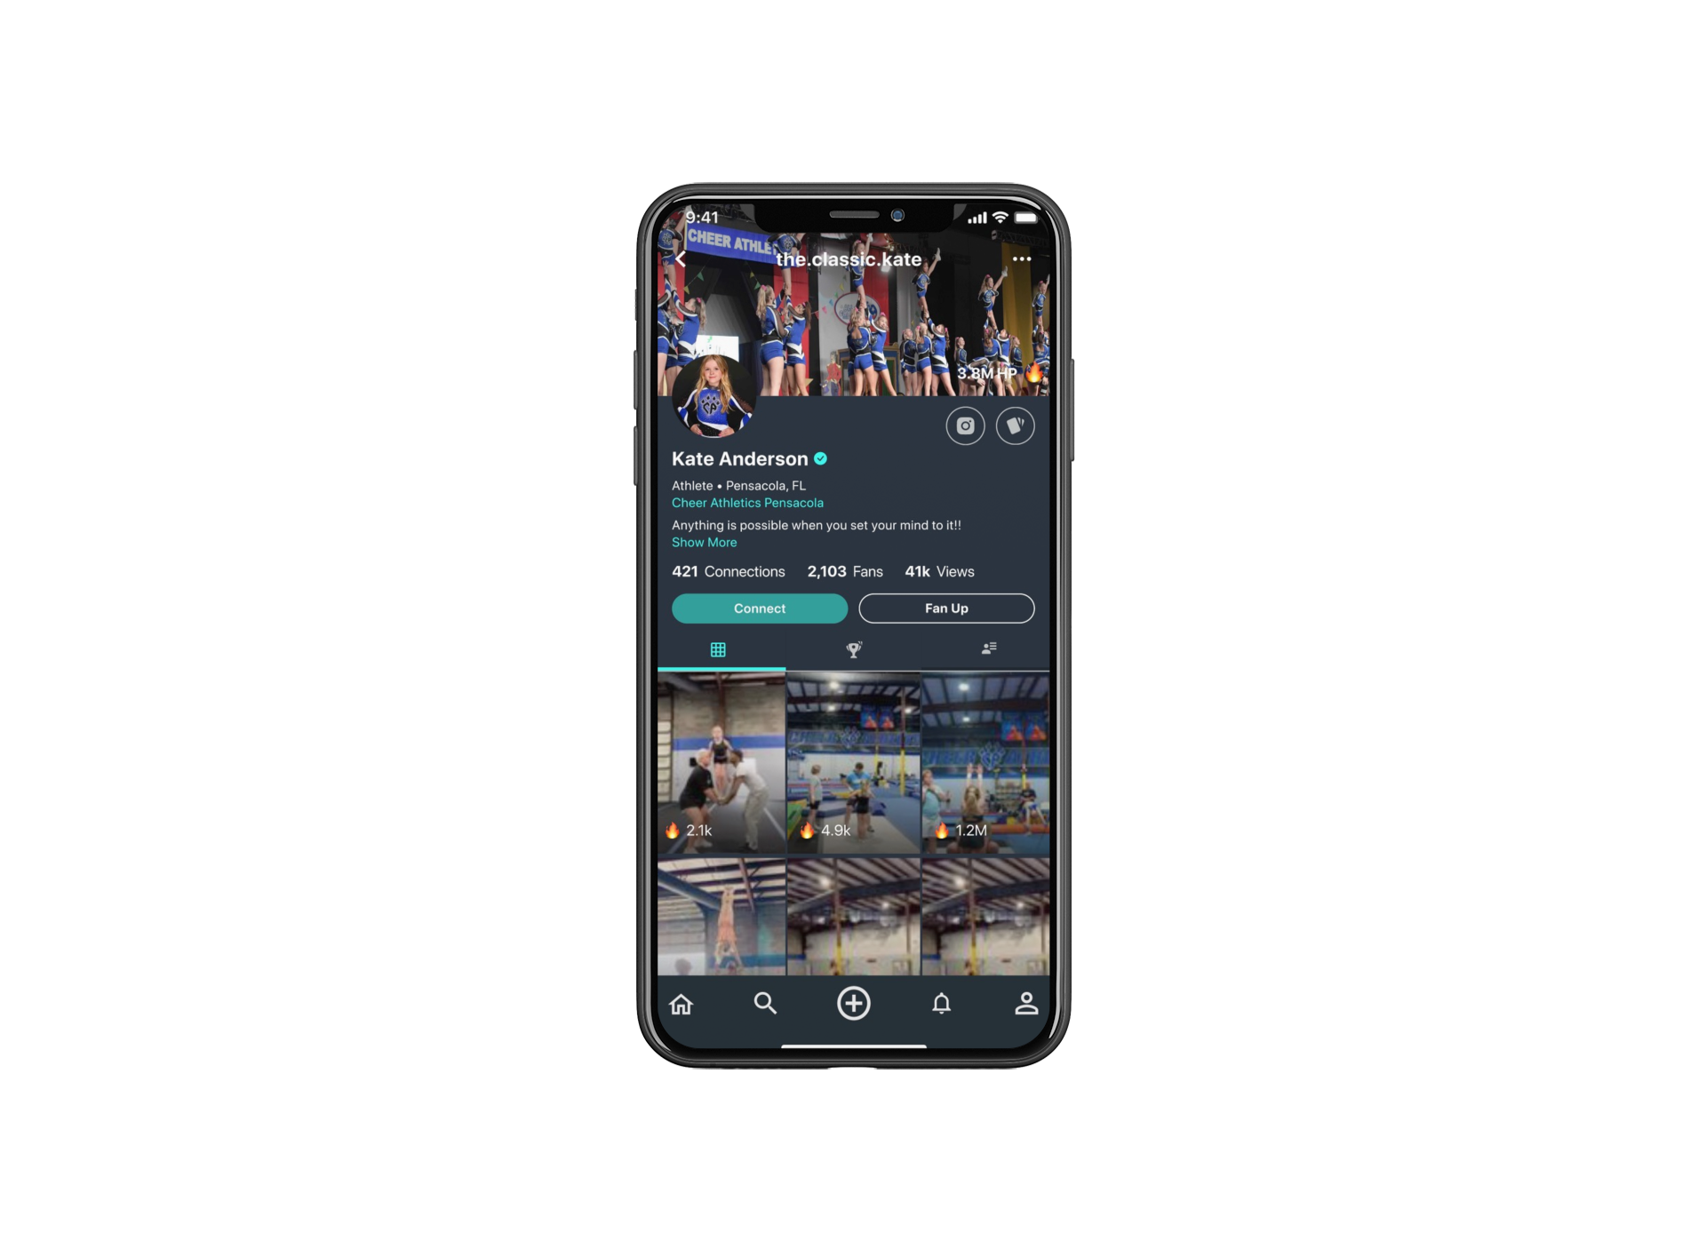
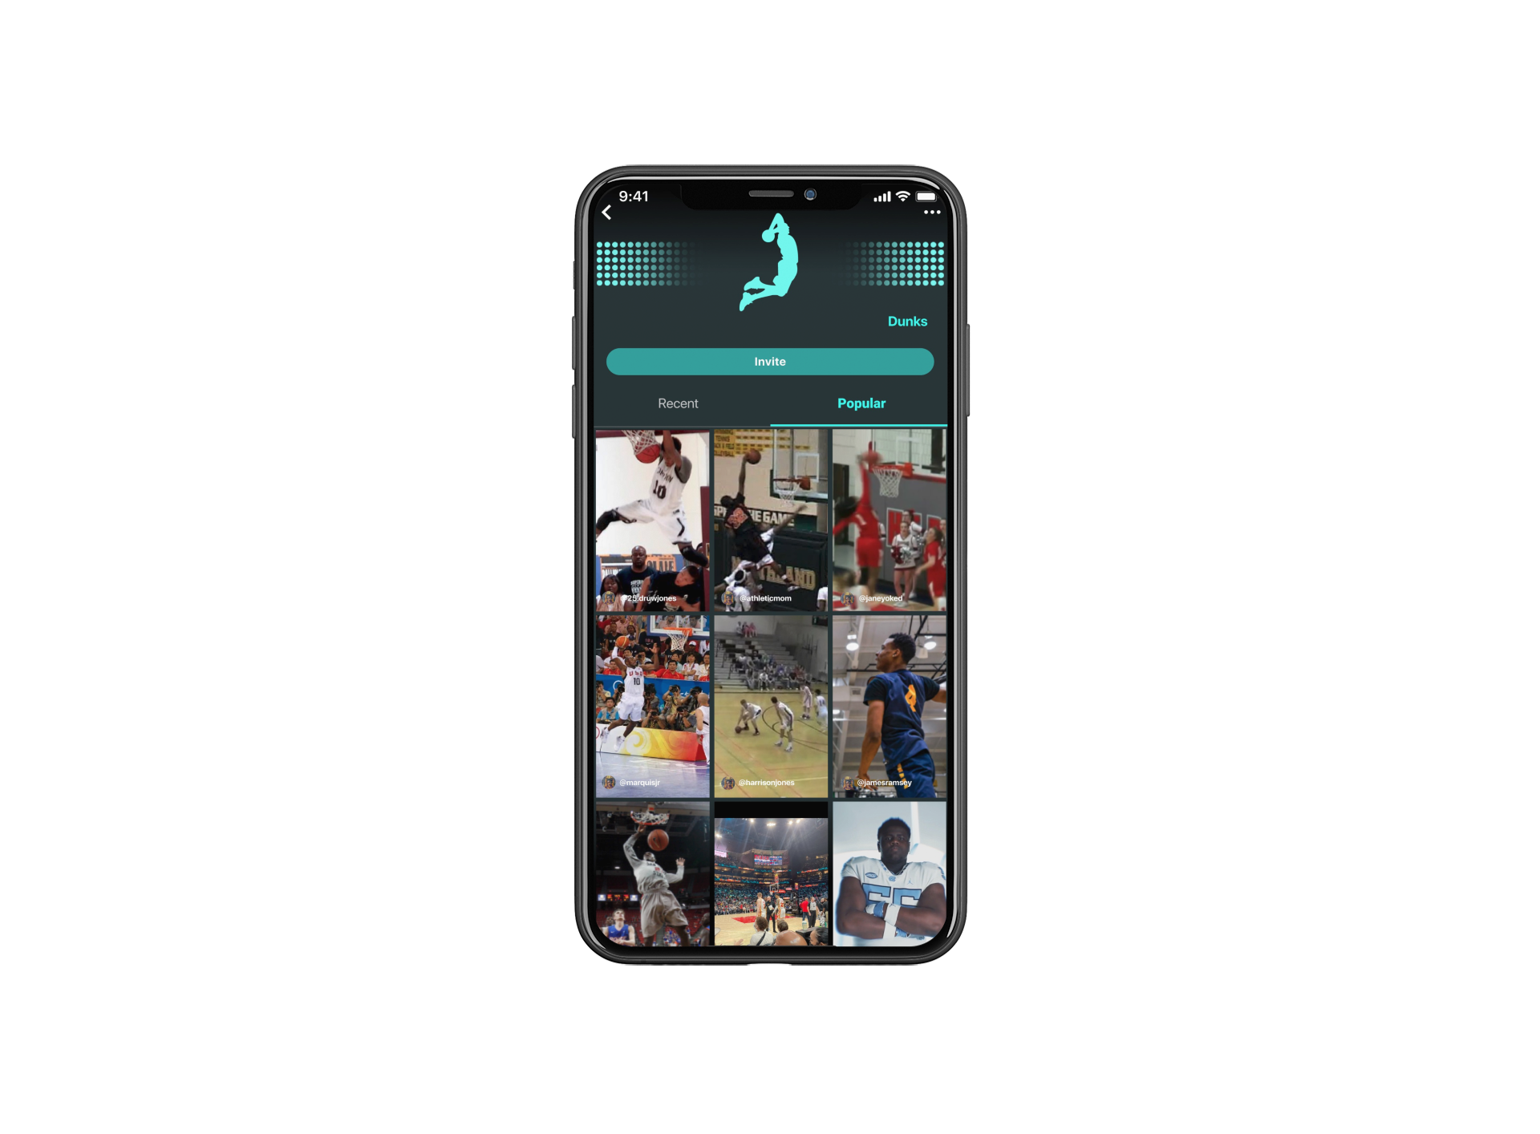
Press Sports is the top sports social platform for amateur athletes looking to connect and share their sports moments.
Athletes across all skill levels and sports share their sports journeys through sharing training to practice to in-game highlights.

Slide 3
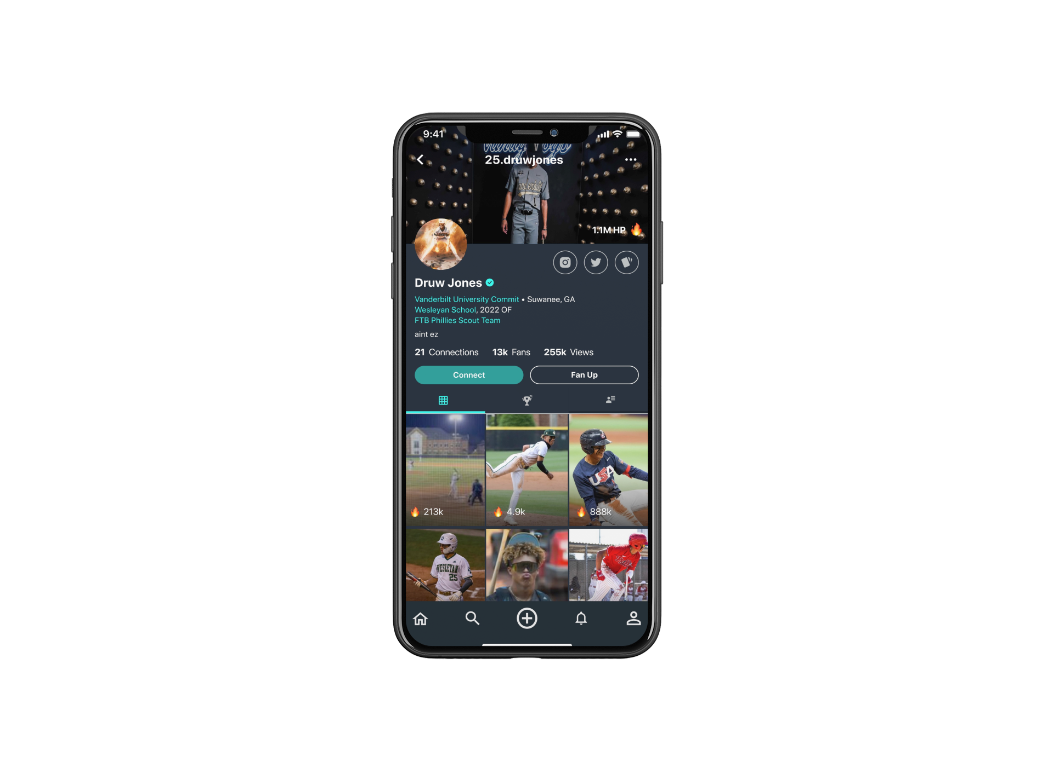
Project Description:
App Engagement
We are searching for a method to analyze and understand the driving factors of engagement with the app and other users around the country.
What is the type of user engagement that drives the highest level of user interaction?

Slide 4
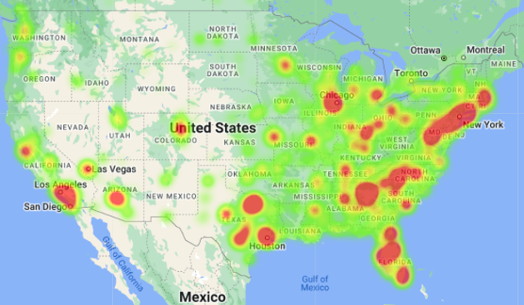
Data Source
The team was able to obtain a large dataset containing information about different users on Press Sports via a CSV file. The file contained user-related information regarding their interaction with the app which was used to facilitate the analysis. This data included 30k+ users with details such as:
IDs
School names/counts
Location
Number of Followers
Notification Counts
Posts
Actions

Slide 5
Questions we wanted to answer:
A higher number of users at a school results in a higher number of posts.
A higher number of users at a school results in a higher number of actions.
A higher number of followers a user has will lead to a higher number of posts.
A higher number of followers a user has will lead to a higher number of actions.
The more notifications a user receives (likes, comments, etc.) will inspire more posts by the user.
The more notifications a user receives (likes, comments, etc.) will inspire more actions by the user.

Slide 6
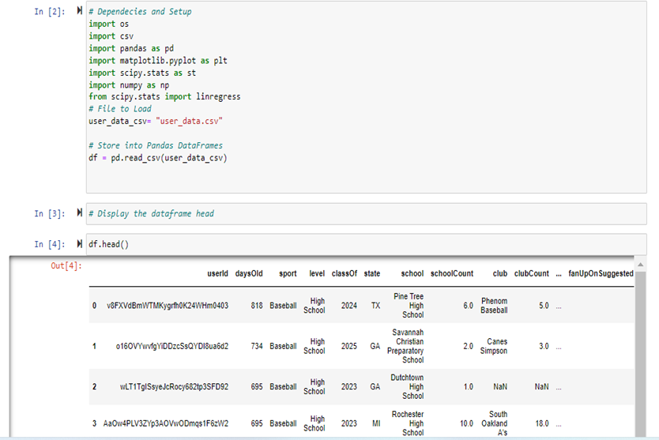
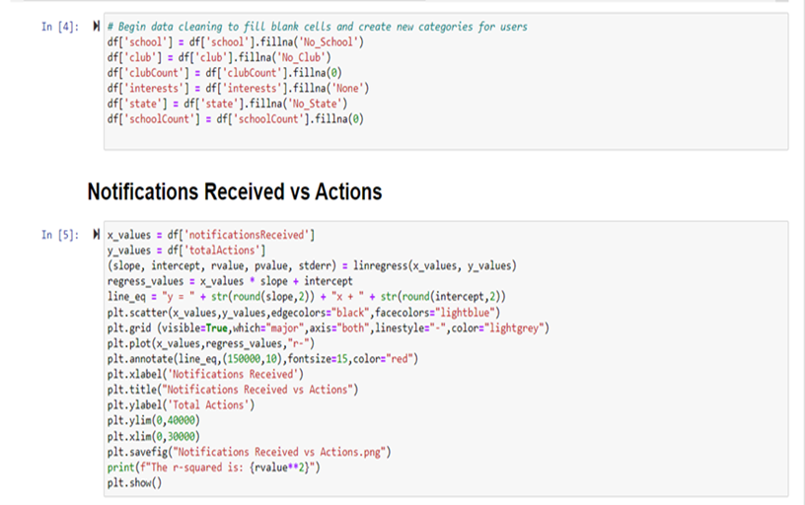
Data Exploration and Cleaning

Slide 7
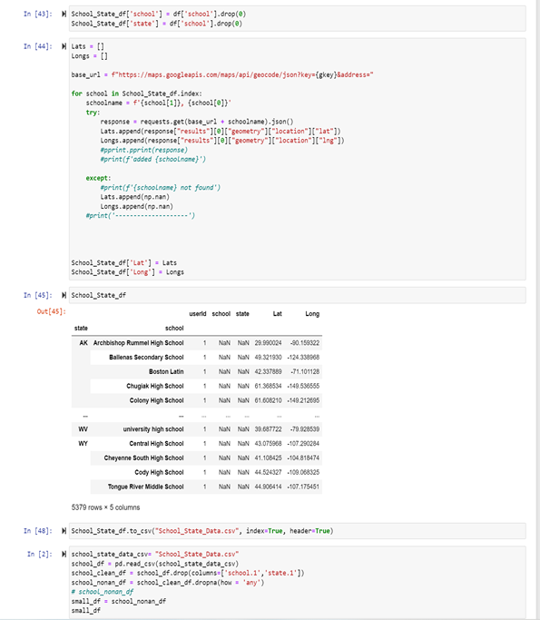
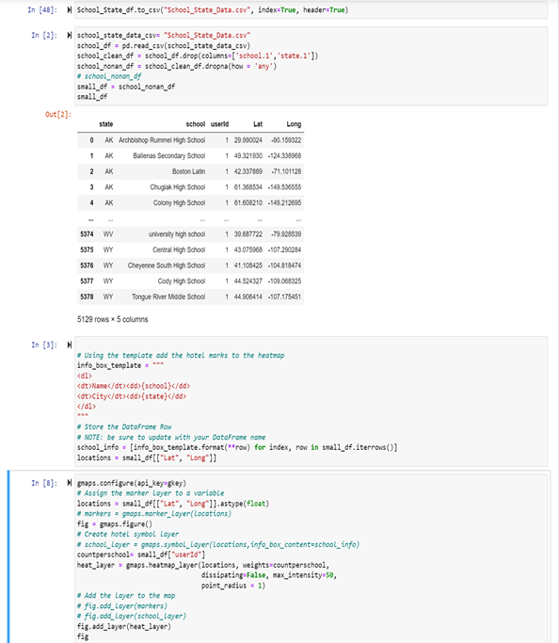
Data Exploration and Cleaning

Slide 8
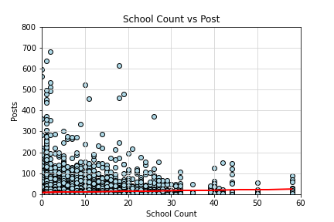
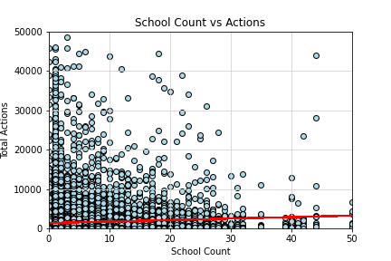
Data Analysis #1:
Testing the hypothesis that the higher number of students at a school will lead to a higher number of posts and actions.
The r-squared is: 0.004
The r-squared is: 0.005

Slide 9
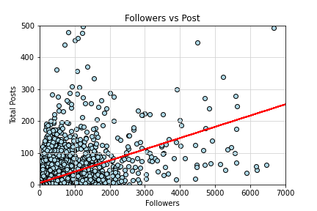
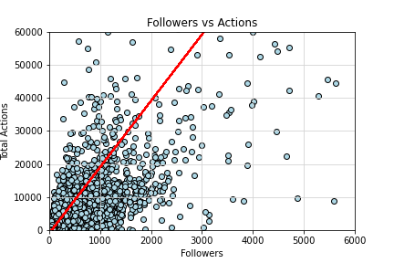
Data Analysis #2:
Testing the hypothesis that the more followers a user has will lead to a higher number of posts and actions.
The r-squared is: 0.3101
The r-squared is: 0.6137

Slide 10
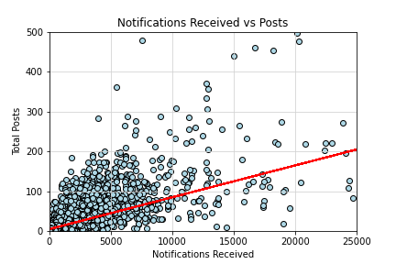
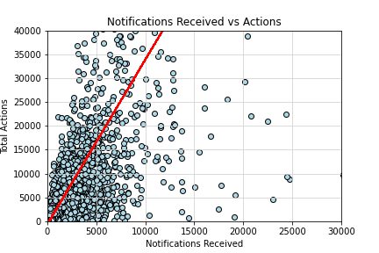
Data Analysis #3:
Testing the hypothesis that the more notifications a user receives will lead to a higher number of posts and actions.
The r-squared is: 0.5107
The r-squared is: 0.5839

Slide 11
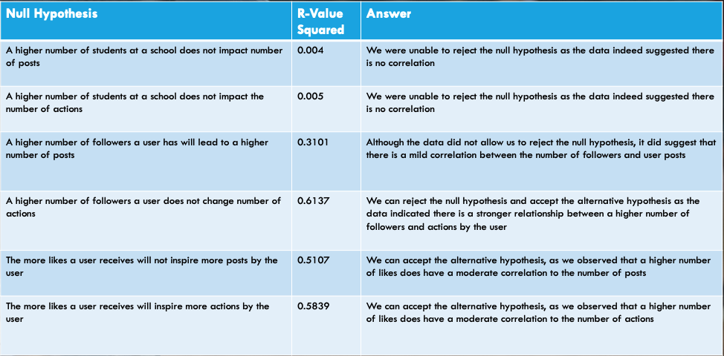
Conclusions

Slide 12
Takeaways
- Although the data suggests there is no correlation between # of students at a school and overall engagement, Team Moneyball believes doing a better job of connecting users at a school inside the app could lead to higher engagement due to increased following counts and notifications being received.
- Helping guide users to connect and grow their followings through inviting friends outside the app should not only help Press Sports increase engagement but also grow their overall user base.
- By helping users connect and grow their followings inside the app, this will lead to more notifications received for a particular which will lead to more engagement and posts inside the app.
- Press Sports will gain a better understanding of where their marketing campaigns or resources may be most effective by using the heatmap provided by Google Maps

Slide 13

LET’S GO!

Slide 14
Why we win & the ecosystem
Focused on social / network effects
Huge head start
Superior ratings/reviews
Focused on content

Slide 15
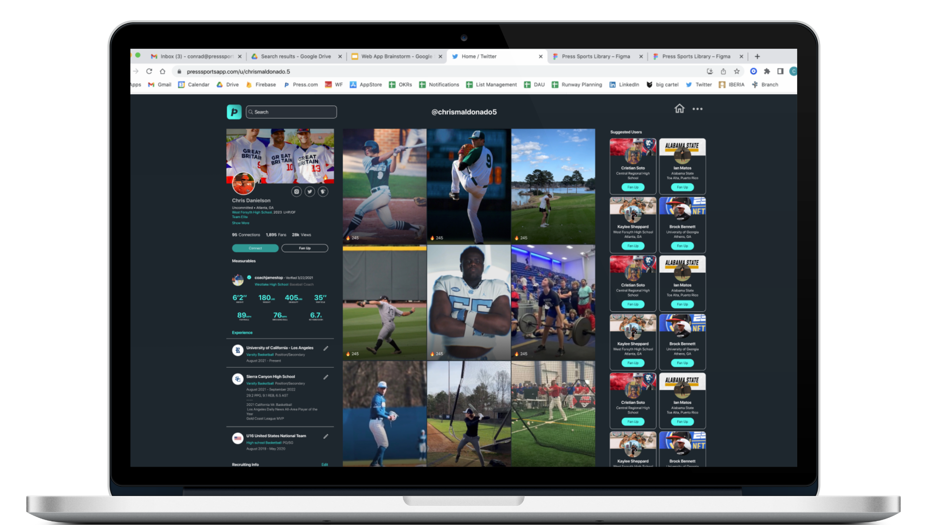
New App Launching in Q2

Slide 16
Why
Gen Z Athletes Love
Press Sports
Just For Athletes
Press Sports provides utility for athletes to capture and share their sports moments with others just like them
Positive Community
Regardless of skill or level of play, the community encourages each other
Gain Exposure
Athletes can easily share their journey with friends, family, teammates and even college recruiters

